Slide 1


Chemical Handling Training Notes
Chemical Handling Training Notes
www.hygieneaustralia.com.au | +61 3 9729 3946 | sales@hygieneaustralia.com.au

Slide 2
Index
What is Chemical Safety?
Guidelines for Handling Chemicals
Hazard Communication Program
Glossary of Common SDS Terms
Chemical Safety and Handling Procedures
Cleaning Equipment - Colour Coding Scheme
Emergency Safety Chart
Contact

Slide 3
What is Chemical Safety?
Chemical safety is preventing accidents and injuries while using chemicals in the workplace.
Chemical Safety Involves:
Knowing the Hazard
Of the chemicals you work with
How they react
How they can affect you
Using Necessary Protection
Such as Personal Protective Equipment (PPE)
Available safety information, e.g. SDS (Safety Data Sheet), Labels, Wall Charts
Follow Sate Work Practices
Each time you handle a chemical

Slide 4
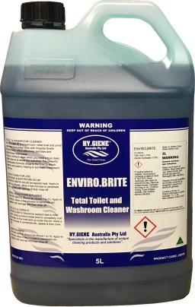
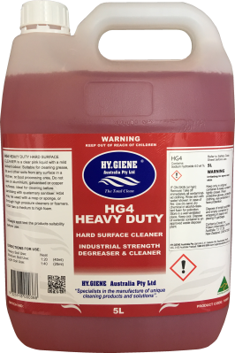
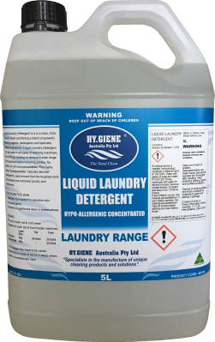
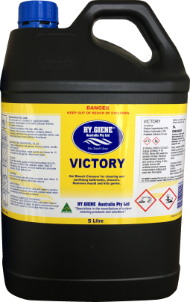
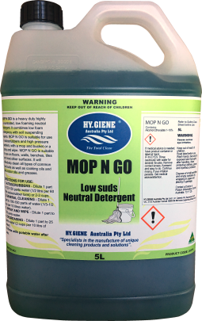
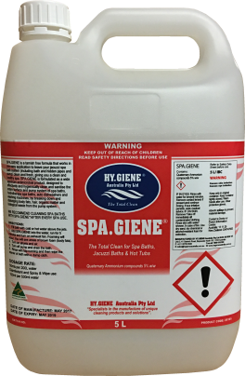
What is Chemical Safety?
Four Main Types of Chemicals
Toxic Agents
These are poisons that can cause illness or death
These can burn skin and eyes
Corrosives
Reactives
These chemicals burn, explode or give off toxic gases if dropped, heated or mixed with other chemicals.
Acids – ENVIRO.BRITE; Alkalis – Bleaches, Hydrogen Peroxide

Slide 5
Flammable and Combustibles
These liquids and gases catch fire easily and burn quickly or explode – Aerosols,
Industrial Methylated Spirits, Mineral Turpentine, Kerosene.
Absorbed - Through the eyes and skin
Inhaled - In the form or dust, gas or vapors
Ingested - Especially if you eat or smoke around chemicals or accidentally induce/swallow them.
How Do I Know What The Risks Are?
By reading the container labels and SDS (Safety Data Sheets)/Wall Charts
Never remove labels from containers
If you can’t find or read a label, tell your supervisor
If you suspect that the label is incorrect for the contents of the container, tell your supervisor.

Slide 6
Follow Safe Work Practices - Don’t take chances when handling chemicals!!
Know what you are handling
Always wear your Personal Protective Equipment
Have adequate ventilation
NEVER MIX CHEMICALS
If unsure or concerned, consult your supervisor
Don’t rely on your sense or smell
Store, Dispense and Dispose of chemicals safely and correctly
Know emergency procedures for:
  Chemical spills and fire
  If you are exposed to chemicals
  First Aid Kits/Eye Wash Bath

Slide 7
Conclusion
PREVENT CHEMICAL ACCIDENTS & INJURIES
KNOW WHAT YOU ARE HANDLING
Read the container label and SDS’s
KNOW THE RISKS
And how to avoid them
FOLLOW SAFE WORK PRACTICES
To protect yourself and others
HAVE A SAFETY FIRST ATTITUDE
All the time

Slide 8
Guidelines for Handling Chemicals
General Rules
Consider all chemicals as hazardous. Read label directions and precautions before use.
Never mix soaps or detergents with sanitizer.
Never add caustic based products to hot or boiling water.
Never mix alkalis with acids.
Never mix acids with products containing chlorine.
NEVER MIX ANY CHEMICALS.

Slide 9
Guidelines for Handling Chemicals
FIRST AID
Area | Response
Eyes | Hold eyes open and flood with water for 15 minutes. Seek medical attention immediately.
Skin Contact | Remove contaminated clothing and wash affected area thoroughly with water.
Inhalation | Remove to fresh air, if patient is not breathing ensure airways are clear and apply artificial resuscitation.
Swallowed | Consult the label, Safety Data Sheet or Poisons Information Centre or seek medical attention immediately.
Spillages | Take extra care if surface becomes slippery. In case of flammable products, extinguish all fire sources, naked flames and turn off mechanical equipment. Contain and pick up for safe disposal. Consult Safety Data Sheet for particulars to absorb, mop up, etc.
Corrosives | DO NOT induce vomiting. Give a glass of water and seek urgent medical attention.

Slide 10
Hazard Communication Program
SAFETY DATA SHEETS – THEIR USE AND PURPOSE
The Safety Data Sheet, often called an SDS, is designed to provide employers and employees with the information necessary to use a chemical substance or mixture safely. The SDS identifies the substance(s) of concern and potential hazards. It describes precautions for use, handling and storage. It also gives procedures for emergency situations.
The SDS from different companies may use different formats, but all should provide the information that is required by the Statutory Authorities. On the HY.GIENE Australia SDS, information is divided into section as following: “Statutory Authorities Regulations in accordance with the respective legislative and government regulations.
HEADING
The heading gives the name and address of the company. The HY.GIENE Australia SDS gives one telephone number for medical emergencies and another for technical information. It also gives the date that the SDS was issued.

Slide 11
Hazard Communication Program
SAFETY DATA SHEETS – THEIR USE AND PURPOSE
IDENTIFICATION
Gives the identity, the product name or number you see on the container label. Describes the type of product.
PHYSICAL DESCRIPTION
Certain physical properties of the reaction or give off noxious fumes. product are reported here. Knowing these properties helps the user choose proper handling and emergency procedures.
OTHER PROPERTIES
Describes the stability of the material under reasonably foreseeable conditions of storage, use and misuse. Conditions that could cause a dangerous reaction or degrade the product are noted. In addition, this section may identify other chemicals that are incompatible. Mixing two incompatible chemicals can produce a violent

Slide 12
Hazard Communication Program
  SAFETY DATA SHEETS – THEIR USE AND PURPOSE
  INGREDIENTS
  Describes major chemical components and lists its proportion in percentage terms.
  HEALTH HAZARD INFORMATION
  Gives the signal word for the product – CAUTION, WARNING or DANGER. A product marked DANGER is the most hazardous. Some products also are marked POISON because of consumer packaging regulations.
  Describes the health hazards and symptoms that can result from eye or skin contact, swallowing or breathing the product.
  There are two types of health hazards”
    Acute – where the adverse effect shows up rapidly as in the case of skin, eye or lung irritation or damage, and
    Chronic – where the adverse effect has symptoms which develop slowly over a long period of time, and which usually result from repeated exposure. Cumulative tissue damage, cancer and birth defects are chronic effects.
  Special information is provided about an individual component in the product, especially is the substance could produce chronic effects from repeated exposure.
  FIRST AID
  Because substances may enter the body by swallowing,by breathing or from skin or eye contact, first aid instructions given for each likely route of exposure. It is important to follow the directions carefully.
  Immediate flushing with water is very crucial to treat eye contact with a corrosive or very irritating substance.
  After first aid treatment the user should contact a poison control center or a physician

Slide 13
Hazard Communication Program
SAFETY DATA SHEETS – THEIR USE AND PURPOSE
PRECAUTIONS FOR USE
This section identifies the hazardous chemicals contained in the product. A chemical component is considered hazardous if exposure to the substance is going to provide significant adverse effect during normal use or predictable misuse. To help the SDS user, the HY.GIENE Australia SDS may also list components that are not hazardous.
If available, a time weighted average (TWA) is provided for each component. A TWA is an airborne concentration limit set for the substance in the workplace (see Glossary). The worker should use protective measures if workplace air concentrations exceed the TWA. Most TWA values are set by the relevant Statutory Authority.
PERSONAL PROTECTION
This section names equipment needed to handle the product without sustaining injury. It describes protective clothing that must be worn and any respiratory protection needed, whether it be personal equipment, exhaust ventilation or both. It may also specify precautions such as eliminating ignition sources when using a flammable product.

Slide 14
Hazard Communication Program
SAFETY DATA SHEETS – THEIR USE AND PURPOSE
FLAMMABILITY
Gives fire fighting guidance and warns of any unusual fire, decomposition or explosion hazards. Most HY.GIENE Australia products will not burn. Some will break down to give off toxic gas if heated in a fire. For those that can give off flammable vapors, flash point values are listed (see Glossary).
SAFE HANDLING
This section gives instructions to handle spills and disposal of unusable material. The user should check all sections of the SDS, including Special Protection Information, before working on a spill. Directions for containment and cleanup are given, including recommended procedures for disposal. Because waste handling rules are complex, the SDS may not name a specific disposal procedure.
OTHER INFORMATION/PRECAUTIONS
This section gives other information that may help the user. The HY.GIENE Australia SDS states the D.G. class, if any. Suggestions for storage may also appear.

Slide 15
Hazard Communication Program
SAFETY DATA SHEETS – THEIR USE AND PURPOSE
SUMMARY
The Safety Data Sheet is prepared and provided for yours and others safety. It is up to
each worker to study it with care and to apply all the required precautions and protections.
Contact your supervisor if you have any questions or further concerns.

Slide 16
Glossary of Common SDS Terms
ACUTE EFFECT
Adverse symptoms that develop rapidly (usually within 24 hours)
ACUTE TOXICITY
Adverse effects that result from a single dose or a brief exposure to a substance
ASPHYXIANT
A vapor or gas that
“C” or CEILING
The maximum allowable workplace concentration limit for an airborne substance.
NOT TO BE EXCEEDED, EVEN MOMENTARILY
CARCINOGEN
A substance or agent that causes cancer.
CHRONIC EFFECT
Symptoms which develop slowly over a long period of time or which recur frequently.
CHRONIC TOXICITY
Adverse effects resulting from repeated or prolonged exposure to a substance.

Slide 17
Glossary of Common SDS Terms
COMBUSTIBLE MATERIAL
Material that burns after being heated sufficiently; flashpoint above 38ºC.
CORROSIVE
A substance that causes chemical burns or destructively attacks body tissue.
DECOMPOSITION
Chemical breakdown of a substance.
DERMAL
By or through the skin
FLASH POINT
The lowest temperature at which a liquid will give off enough flammable vapor to ignite when exposed to a flame.
FLAMMABLE MATERIAL
A material that catches fire readily and burns rapidly; flash point of 38ºC or less.
FLAMMABLE MATERIAL
A material that catches fire readily and burns rapidly; flash point of 38ºC or less.
INGESTION
Swallowing.

Slide 18
Glossary of Common SDS Terms
IRRITANT
Can cause an inflammatory response or reaction to the eye, skin or respiratory system at the site of contact.
MUTAGEN
Causes mutations in DNA and living cells.
OXIDIZER
Any substance that releases
Ph
Measures how acidic or caustic an aqueous liquid is on a scale of 1-14; pH=1 is very acidic, pH=7 indicates a neutral solution and pH=14 indicates a very caustic (basic, alkaline) solution.
PEL
Permissible Exposure Limit.
REACTIVITY
The relative ability of a substance to undergo chemical change by combining with another substance or by breaking down. Certain conditions such as heat and light may make a substance more reactive. An explosion is a very rapid reaction

Slide 19
Glossary of Common SDS Terms
SENSITIZER
Repeated exposure may cause a marked reaction not necessarily limited to the site of contact.
SOLUBILITY
The amount of substance that can be dissolved in a solvent, usually water.
STEL
Short Term Exposure Limit (often 15 minutes); a TLV
TERATOGEN
Causes growth abnormalities in the fetus.
TLV
Threshold Limit Value; the airborne concentration of a substance calculated to be safe for most workers. The TLV is measure in units of parts per million (ppm) or milligrams per cubic metre (mg/m3). The PEL, STEL and TWA are types of TLV.
TOXICITY
The capacity of a substance to product a harmful effect when the substance has reached a sufficient concentration at a certain site in the body.
TOXIC SUBSTANCE
A substance which can cause acute or chronic injury.
TWA
Time weighted average. The TLV for an eight hour working day.

Slide 20
Chemical Safety and Handling Procedures
1. LABELS
Ensure the bottle has the correct product in it and the correct label.
Do not use unlabelled chemicals and replace any labels which are damaged or illegible.
2. CORRECT USE OF CHEMICALS
Always use chemicals as per the instructions on the label, product information sheets, wall charts and on the
Safety Data Sheet.
3. READ THE SDS BEFORE YOU USE ANY CHEMICALS
Not all the information you need is on the label.
It is your responsibility to always know where the chemical register is kept.
4. CHEMICALS – SAFE HANDLING
Do not mix chemicals. It is hazardous and can be counter productive.
Do not “Top Up.” It is hazardous and can lead to cross contamination.
Do not overdose and do not under dose.
Always use a clean empty container.
Once empty, decanting containers should be cleaned and disinfected, allowed to air-dry, ready for use next time.
Do not bring your own chemicals to the workplace. All chemicals must be approved by Management.
5. RETURN CHEMICALS AFTER USE
When finished with chemicals wipe down the bottles and store them away safely in their appropriate location.

Slide 21
Chemical Safety and Handling Procedures
6. ALWAYS WEAR APPROPRIATE PROTECTIVE CLOTHING (P.P.E.)
i.e. Aprons, Gloves, Goggles or Glasses, Safety Footwear, Masks, etc (As per the SDS).
P.P.E. that is reused must be cleaned and returned after use.
7. REPORT ALL SPILLS, ACCIDENTS & ILL EFFECTS
Ensure Spill Kits are available and easily accessible. Remove spills as per SDS directions.
If unable to contain spills safely activate code YELLOW
8. FIRST AID KIT
First Aid Kits should be easily accessible and contain an eye washer.
9. NEVER STACK CHEMICALS MORE THAN 3 DRUMS HIGH
Stacking chemical drums and boxes more than 3 high is unsafe and may fall, causing damage.
It is advisable to store powders above liquids.
10. IF IN DOUBT THROW IT OUT
If you are not sure of a product, label, etc., DO NOT USE. Notify your supervisor so it can be disposed of properly.
11. OBSERVE SAFE OPERATION OF DISPENSING EQUIPMENT
Ensure all staff know how to operate chemical dispensing systems safely.

Slide 22
Chemical Safety and Handling Procedures
12. USE OF CONTAINERS
Seal containers when not in use.
Do not open damaged containers. Return them or seek advice from your supplier.
13. HYGIENE
Always wash your hands after using chemicals (even if gloves were worn).
14. VENTILATION
Ensure there is adequate ventilation in the storeroom and when using the chemicals
15. SAFETY
If in doubt as to the correct use of the chemical, DO NOT USE.
16. SMOKING
Do not smoke anywhere near the chemicals or whilst you are using the chemicals.
17. FOOD SAFETY
Do not use any chemicals near food.
18. CORRECT CHEMICAL, CORRECT JOB
Always use the right chemicals for the right job
19. PERSONAL PROTECTIVE EQUIPMENT
Must also be worn when handling chemicals to pack, unpack, store, use and dispose.

Slide 23
Chemical Safety and Handling Procedures
MOST IMPORTANTLY…USE COMMON SENSE.
We must all take every precaution when using chemicals to ensure that your own, other workers’ and the public’s safety is optimised.

Slide 24
Cleaning Equipment - Colour Coding Scheme
GREEN Food Service and Preparation Areas
RED Toilets, Bathrooms and Dirty Utility Rooms
BLUE General Cleaning
WHITE Operating Theatre
YELLOW Infectious Areas

Slide 25
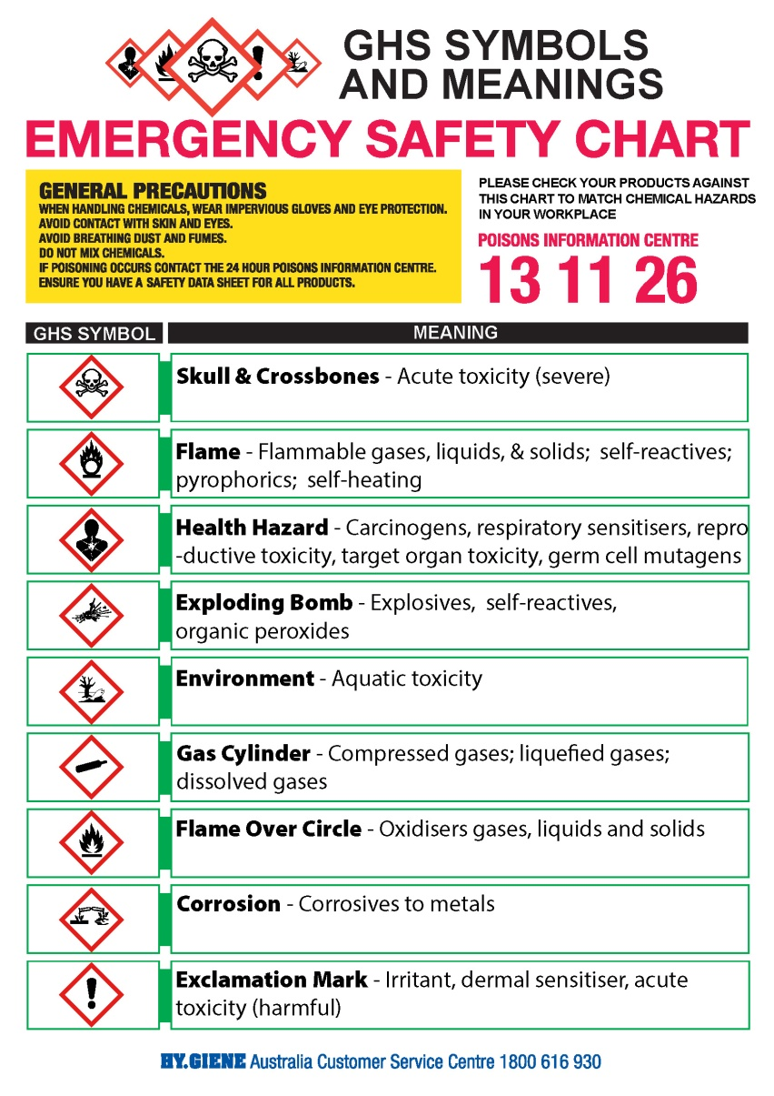
Emergency Safety Chart

Slide 26

Contact
Hy.Giene Australia
ABN 34 271 614 027
PO Box 910
Bayswater VIC,
3153 Australia
PH: +61 3 9729 3946
Fax: +61 3 9729 3942
Email: sales@hygieneaustralia.com.au
www.hygieneaustralia.com.au

